Slide 1

Bullfrog
“Block the Burn, and Bite”
Proposed Media Plan
Team 6
Rikki Kline
Buck Posey
Ashley Ciesielczyk
Aaron Greenfield

Slide 2
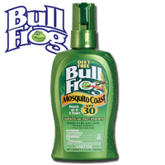
Situation Analysis
Media Objectives
  Create New Users
  Inform Consumer of Benefits
  Create Awareness of Sun Damage to Skin
  Specific Media Projection
Variable of Consumers
  The amount of time our users spend in the sun during season.
  The added benefit of a 2 in 1 properties which make it more appealing.
  Need for something they don’t need to constantly reapply.

Slide 3

Situation Analysis
Target Market
Parents - generally with more responsibilities for taking care of their children while involved in a variety out outdoor activities.
Three Children HH’s - parents with more children will feel better knowing their children are better protected from the elements all day.
Consumer Needs
Long lasting sunscreen
Full protection
Variety of product types

Slide 4
SWOT
Strengths Unique product design Available growth Unsatisfied markets with potential Areas with low BDI Repurchase cycle | Weakness Low brand loyalty Brand awareness Strong competition Low share of voice Product placement
Opportunities Better product placement Better advertising Concern about insect carried diseases More defined target market Growing concerns over skin health | Threats Growing competition Growing advertising spent by competitors Lack of dominance in brand category New repellant being developed Extremely broad market with all brands

Slide 5
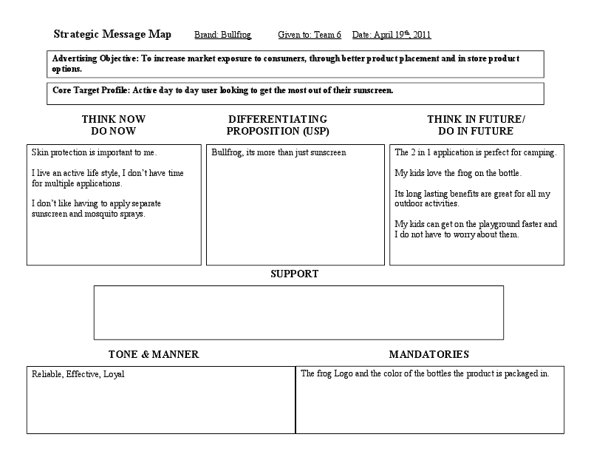
Creative Brief

Slide 6
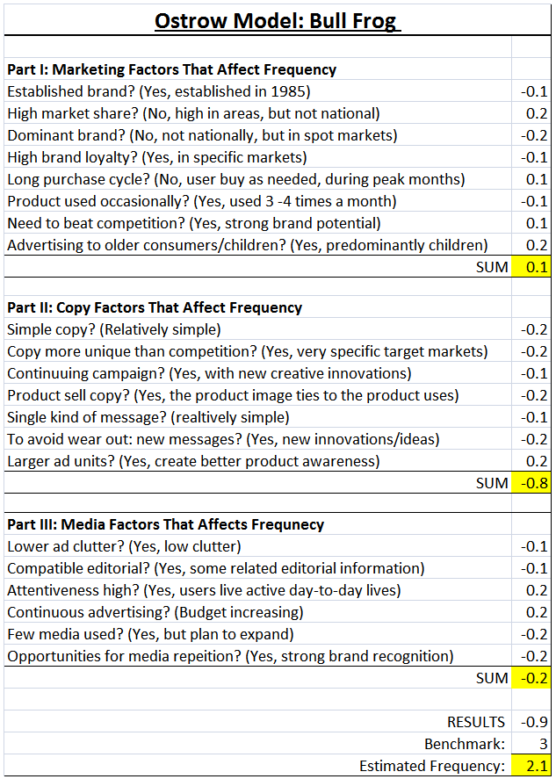
Creative Brief

Slide 7
Industry Media Spending

Slide 8

Proposed Media Spending

Slide 9
Proposed Media Plan

Slide 10
Media Delivery Metrics
Outdoor
Cities | Population 25-34 | % of Observers | # Reached
Phoenix, AZ | 602,500 | 13% | 78,325
Denver, CO | 540,000 | 13% | 70,200
San Diego, CA | 442,600 | 13% | 57,538
Portland, OR | 396,700 | 13% | 51,571
Charlotte, NC | 367,700 | 13% | 47,801
Raleigh, NC | 376,200 | 13% | 48,906
Nashville, TN | 327,300 | 13% | 42,549
San Antonio, TX | 284,900 | 13% | 37,037
Norfolk, VA | 245,600 | 13% | 31,928
Memphis, TN | 242,200 | 13% | 31,486
Total Reached |  |  | 497,341
Radio
Cities | Population 25-34 | % of Listeners | # Reached
Phoenix, AZ | 602,500 | 10% | 60,250
Denver, CO | 540,000 | 10% | 54,000
San Diego, CA | 442,600 | 10% | 44,260
Portland, OR | 396,700 | 10% | 39,670
Charlotte, NC | 367,700 | 10% | 36,770
Raleigh, NC | 376,200 | 10% | 37,620
Nashville, TN | 327,300 | 10% | 32,730
San Antonio, TX | 284,900 | 10% | 28,490
Norfolk, VA | 245,600 | 10% | 24,560
Memphis, TN | 242,200 | 10% | 24,220
Total Reached |  |  | 382,570

Slide 11
Media Delivery Metrics
Magazines
Cities | Population 25- 34 | % of Readership | # Reached
Phoenix, AZ | 602,500 | 8% | 48,200
Denver, CO | 540,000 | 8% | 43,200
San Diego, CA | 442,600 | 8% | 35,408
Portland, OR | 396,700 | 8% | 31,736
Charlotte, NC | 367,700 | 8% | 29,416
Raleigh, NC | 376,200 | 8% | 30,096
Nashville, TN | 327,300 | 8% | 26,184
San Antonio, TX | 284,900 | 8% | 22,792
Norfolk, VA | 245,600 | 8% | 19,648
Memphis, TN | 242,200 | 8% | 19,376
Total Reached |  |  | 306,056
Cities chosen based on assumption that majority of population participate in outdoor activities.
These different types of media were selected as they are aimed to reaching our desired target markets.
GRPS= 302000/100= 3020

